Slide 1
Automated Classification of Lung Cancer Types from Cytological Images Using Deep Convolutional Neural Networks
Paper By: Teramoto A., Tsukamoto T., Kiriyama Y., Fujita H.
Presented by: Jeremy Hui

Slide 2
Introduction
Lung Cancer is one of the leading causes of death worldwide
Accurate classification of cancer types is required for accurate and stable diagnosis
Primary Lung Cancers
Small cell lung cancer
Non-small cell lung cancer

Slide 3
Introduction
Non-small cell lung cancer can be further classified into
Adenocarcinoma
Squamous cell carcinoma
Large cell carcinoma
Large cell carcinoma is easiest to detect
Focuses on adenocarcinoma, squamous cell carcinoma and small cell carcinoma

Slide 4
Previous work
D. C. Ciresan, A. Giusti, L. M. Gambardella, and J. Schmid- huber, “Mitosis detection in breast cancer histology images with deep neural networks,” in Medical Image Computing and Computer-Assisted Intervention—MICCAI 2011, vol. 8150 of Lecture Notes in Computer Science, pp. 411–418, Springer, Berlin, Germany, 2013.
H. Wang, A. Cruz-Roa, A. Basavanhally et al., “Mitosis detec- tion in breast cancer pathology images by combining hand- crafted and convolutional neural network features,” Journal of Medical Imaging, vol. 1, no. 3, p. 034003, 2014.

Slide 5
Approach
Automated classification for lung cancers presented in microscopic images using a deep convolutional neural network (DCNN)
Architecture
3 convolutional layers
3 pooling layers
2 fully connect layers

Slide 6
Image Dataset
76 cases of cancer cells collected
40 cases of adenocarcinoma
20 cases of squamous cell carcinoma
16 cases of small cell carcinoma
Digital camera attached to microscope with x40 objective lens used to take images
82 images of adenocarcinoma
125 images of squamous cell carcinoma
91 images of small cell carcinoma

Slide 7
Image Dataset
Images in JPEG format of matrix size 2040 x 1536 pixels
768 x 768 square images were cropped
Resized to 256 x 256 pixels

Slide 8
Data Augmentation
DCNN requires a sufficient amount of training data
Rotating, inverting and filtering applied to the original images
Images were flipped, resulting in twice the original number
Gaussian filter applied in filtering
S.D of Gaussian kernel = 3 pixels
Convolutional edge enhancement filter was applied
Center weight 5.4, 8-surrounding weight -0.55

Slide 9
Architecture
3 convolutional layers, 3 pooling layers, 2 fully connected layers
Rectified linear unit (ReLU) activation function after every convolution layer
Probabilities of cancer types (adenocarcinoma, squamous cell carcinoma, small cell carcinoma) obtained using softmax function
Dropout rate = 50% for full connection layers
Number of epochs = 60,000

Slide 10
Architecture

Slide 11
Results
3 fold cross-validation

Slide 12
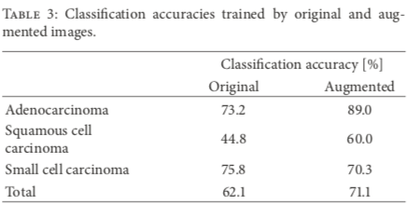
Results

Slide 13
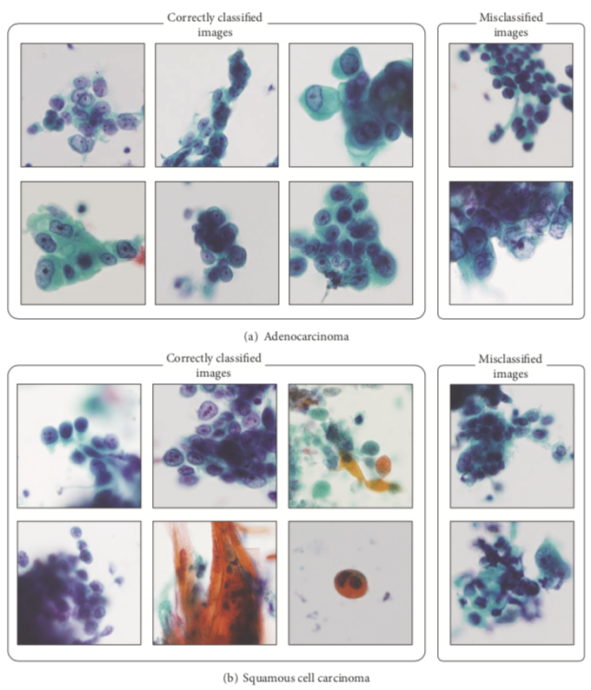
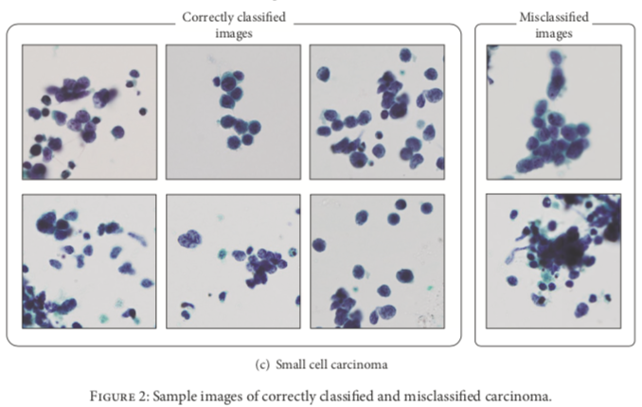
Results

